Slide 1
ECE408/CS483 Fall 2015 Applied Parallel Programming Lecture 4: Kernel-Based Data Parallel Execution Model

Slide 2
A Multi-Dimensional Grid Example
host
device
Grid 1
Block (0, 0)
Block (0, 1)
Kernel 1
Block (1, 0)
Block (1, 1)
Block (1,1)
(1,0,0)
(1,0,1)
(1,0,2)
(1,0,3)
Thread
(0,0,0)
Thread
(0,0,1)
Thread
(0,0,2)
Thread
(0,0,3)
Thread
(0,0,0)
Thread
(0,1,3)
Thread
(0,1,0)
Thread
(0,1,1)
Thread
(0,1,2)

Slide 4
Row-Major Layout in C/C++
M_{0,0}
M_{0,1}
M_{0,2}
M_{0,3}
M_{1,0}
M_{1,1}
M_{1,2}
M_{1,3}
M_{2,0}
M_{2,1}
M_{2,2}
M_{2,3}
M_{3,0}
M_{3,1}
M_{3,2}
M_{3,3}
M
M_{0,0}
M_{0,1}
M_{0,2}
M_{0,3}
M_{1,0}
M_{1,1}
M_{1,2}
M_{1,3}
M_{2,0}
M_{2,1}
M_{2,2}
M_{2,3}
M_{3,0}
M_{3,1}
M_{3,2}
M_{3,3}
M
M₀
M₁
M₂
M₃
M₄
M₅
M₆
M₇
M₈
M₉
M₁₀
M₁₁
M₁₂
M₁₃
M₁₄
M₁₅
M_{2,1} → Row*Width+Col = 2*4+1 = 9

Slide 5
Source Code of the PictureKernel
__global__ void PictureKernel(float* Pin, float* Pout, int n, int m)
{
// Calculate the row # of the Pin and Pout element to process
int Row = blockIdx.y*blockDim.y + threadIdx.y;
// Calculate the column # of the Pin and Pout element to process
int Col = blockIdx.x*blockDim.x + threadIdx.x;
// each thread computes one element of Pout if in range
if ((Row < m) && (Col < n)) {
Pout[Row*n+Col] = 2*Pin[Row*n+Col];
}
}

Slide 6
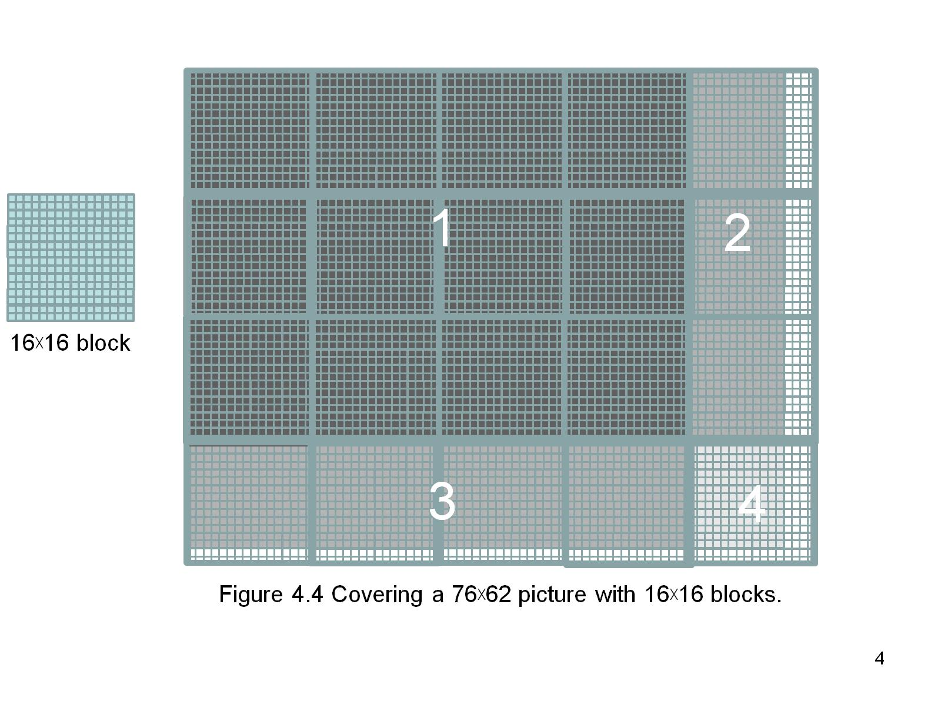
ddd
Figure 4.5 Covering a 76×62 picture with 16×blocks.

Slide 7
A Simple Running Example Matrix Multiplication
A simple illustration of the basic features of memory and thread management in CUDA programs
Thread index usage
Memory layout
Register usage
Assume square matrix for simplicity
Leave shared memory usage until later

Slide 8
Square Matrix-Matrix Multiplication
P = M * N of size WIDTH x WIDTH
Each thread calculates one element of P
Each row of M is loaded WIDTH times from global memory
Each column of N is loaded WIDTH times from global memory
N
WIDTH
M
P
WIDTH
WIDTH
WIDTH

Slide 9
Row-Major Layout in C/C++
M_{0,0}
M_{0,1}
M_{0,2}
M_{0,3}
M_{1,0}
M_{1,1}
M_{1,2}
M_{1,3}
M_{2,0}
M_{2,1}
M_{2,2}
M_{2,3}
M_{3,0}
M_{3,1}
M_{3,2}
M_{3,3}
M
M_{0,0}
M_{0,1}
M_{0,2}
M_{0,3}
M_{1,0}
M_{1,1}
M_{1,2}
M_{1,3}
M_{2,0}
M_{2,1}
M_{2,2}
M_{2,3}
M_{3,0}
M_{3,1}
M_{3,2}
M_{3,3}
M
M₀
M₁
M₂
M₃
M₄
M₅
M₆
M₇
M₈
M₉
M₁₀
M₁₁
M₁₂
M₁₃
M₁₄
M₁₅
M_{2,1} → Row*Width+Col = 2*4+1 = 9

Slide 10
Matrix Multiplication A Simple Host Version in C
// Matrix multiplication on the (CPU) host in double precision
void MatrixMulOnHost(float* M, float* N, float* P, int Width)
{
for (int i = 0; i < Width; ++i)
for (int j = 0; j < Width; ++j) {
double sum = 0;
for (int k = 0; k < Width; ++k) {
double a = M[i * Width + k];
double b = N[k * Width + j];
sum += a * b;
}
P[i * Width + j] = sum;
}
}
N
k
j
WIDTH
M
P
i
WIDTH
k
WIDTH
WIDTH
Notes:
Point out that I and j will become global thread indices.

Slide 11
Kernel Function - A Small Example
Have each 2D thread block to compute a (TILE_WIDTH)² sub-matrix (tile) of the result matrix
Each has (TILE_WIDTH)² threads
Generate a 2D Grid of (WIDTH/TILE_WIDTH)² blocks
Block(0,0)
Block(0,1)
P_{0,0}
P_{0,1}
P_{0,2}
P_{0,3}
WIDTH = 4; TILE_WIDTH = 2
Each block has 2*2 = 4 threads
P_{1,0}
P_{1,1}
P_{1,2}
P_{1,3}
P_{2,0}
P_{2,1}
P_{2,2}
P_{2,3}
WIDTH/TILE_WIDTH = 2
Use 2* 2 = 4 blocks
P_{3,0}
P_{3,1}
P_{2,3}
P_{3,3}
Block(1,0)
Block(1,1)

Slide 12
A Slightly Bigger Example
P_{0,0}
P_{0,1}
P_{0,2}
P_{0,3}
P_{0,4}
P_{0,5}
P_{0,6}
P_{0,7}
P_{1,0}
P_{1,1}
P_{1,2}
P_{1,3}
P_{1,4}
P_{1,5}
P_{1,6}
P_{1,7}
P_{2,0}
P_{2,1}
P_{2,2}
P_{2,3}
P_{2,4}
P_{2,5}
P_{2,6}
P_{2,7}
WIDTH = 8; TILE_WIDTH = 2
Each block has 2*2 = 4 threads
P_{3,0}
P_{3,1}
P_{3,2}
P_{3,3}
P_{3,4}
P_{3,5}
P_{3,6}
P_{3,7}
P_{4,0}
P_{4,1}
P_{4,2}
P_{4,3}
P_{4,4}
P_{4,5}
P_{4,6}
P_{4,7}
P_{5,0}
P_{5,1}
P_{5,2}
P_{5,3}
P_{5,4}
P_{5,5}
P_{5,6}
P_{5,7}
WIDTH/TILE_WIDTH = 4
Use 4* 4 = 16 blocks
P_{6,0}
P_{6,1}
P_{6,2}
P_{6,3}
P_{6,4}
P_{6,5}
P_{6,6}
P_{6,7}
P_{7,0}
P_{7,1}
P_{7,2}
P_{7,3}
P_{7,4}
P_{7,5}
P_{7,6}
P_{7,7}

Slide 13
Kernel Invocation (Host-side Code)
// Setup the execution configuration
// TILE_WIDTH is a #define constant
dim3 dimGrid(Width/TILE_WIDTH, Width/TILE_WIDTH, 1);
dim3 dimBlock(TILE_WIDTH, TILE_WIDTH, 1);
// Launch the device computation threads!
MatrixMulKernel<<<dimGrid, dimBlock>>>(Md, Nd, Pd, Width);

Slide 14
Work for Block (0,0) in a TILE_WIDTH = 2 Configuration
blockDim.x
blockDim.y
Col = 0
Col = 1
Col = 0 * 2 + threadIdx.x
Row = 0 * 2 + threadIdx.y
N_{0,0}
N_{0,1}
N_{0,2}
N_{0,3}
N_{1,0}
N_{1,1}
N_{1,2}
N_{1,3}
blockIdx.x
blockIdx.y
N_{2,0}
N_{2,1}
N_{2,2}
N_{2,3}
N_{3,0}
N_{3,1}
N_{3,2}
N_{3,3}
Row = 0
M_{0,0}
M_{0,1}
M_{0,2}
M_{0,3}
P_{0,0}
P_{0,1}
P_{0,2}
P_{0,3}
Row = 1
M_{1,0}
M_{1,1}
M_{1,2}
M_{1,3}
P_{1,0}
P_{1,1}
P_{1,2}
P_{1,3}
M_{2,0}
M_{2,1}
M_{2,2}
M_{2,3}
P_{2,0}
P_{2,1}
P_{2,2}
P_{2,3}
M_{3,0}
M_{3,1}
M_{3,2}
M_{3,3}
P_{3,0}
P_{3,1}
P_{3,2}
P_{3,3}

Slide 15
Work for Block (0,1)
Col = 2
Col = 3
Col = 1 * 2 + threadIdx.x
Row = 0 * 2 + threadIdx.y
N_{0,0}
N_{0,1}
N_{0,2}
N_{0,3}
N_{1,0}
N_{1,1}
N_{1,2}
N_{1,3}
blockIdx.x
blockIdx.y
N_{2,0}
N_{2,1}
N_{2,2}
N_{2,3}
N_{3,0}
N_{3,1}
N_{2,3}
N_{3,3}
Row = 0
M_{0,0}
M_{0,1}
M_{0,2}
M_{0,3}
P_{0,0}
P_{0,1}
P_{0,2}
P_{0,3}
Row = 1
M_{1,0}
M_{1,1}
M_{1,2}
M_{1,3}
P_{0,1}
P_{1,1}
P_{1,2}
P_{1,3}
M_{2,0}
M_{2,1}
M_{2,2}
M_{2,3}
P_{2,0}
P_{2,1}
P_{2,2}
P_{2,3}
M_{3,0}
M_{3,1}
M_{3,2}
M_{3,3}
P_{3,0}
P_{3,1}
P_{3,2}
P_{3,3}

Slide 16
A Simple Matrix Multiplication Kernel
__global__ void MatrixMulKernel(float* M, float* N, float* P, int Width)
{
// Calculate the row index of the P element and M
int Row = blockIdx.y * blockDim.y + threadIdx.y;
// Calculate the column index of P and N
int Col = blockIdx.x * blockDim.x + threadIdx.x;
if ((Row < Width) && (Col < Width)) {
float Pvalue = 0;
// each thread computes one element of the block sub-matrix
for (int k = 0; k < Width; ++k)
Pvalue += M[Row*Width+k] * N[k*Width+Col];
P[Row*Width+Col] = Pvalue;
}
}

Slide 17
CUDA Thread Block
All threads in a block execute the same kernel program (SPMD)
Programmer declares block:
Block size 1 to 1024 concurrent threads
Block shape 1D, 2D, or 3D
Threads have thread index numbers within block
Kernel code uses thread index and block index to select work and address shared data
Threads in the same block share data and synchronize while doing their share of the work
Threads in different blocks cannot cooperate
Each block can execute in any order relative to other blocks!
CUDA Thread Block
Thread Id #: 0 1 2 3 … m
Thread program
Courtesy: John Nickolls, NVIDIA

Slide 18
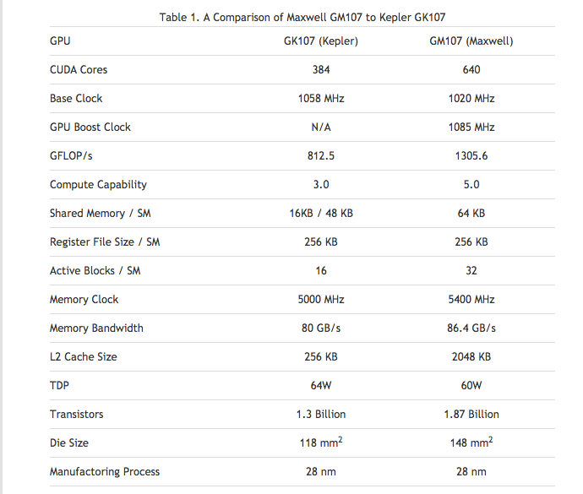
Compute Capabilities are GPU Dependent

Slide 19
Executing Thread Blocks
SM 0
SM 1
t0 t1 t2 … tm
t0 t1 t2 … tm
MT IU
MT IU
Blocks
SP
SP
Threads are assigned to Streaming Multiprocessors in block granularity
Up to 32 blocks to each SM as resource allows
Maxwell SM can take up to 2048 threads
Threads run concurrently
SM maintains thread/block id #s
SM manages/schedules thread execution
Blocks
Shared
Memory
Shared
Memory

Slide 20
Thread Scheduling (1/2)
Each Block is executed as 32-thread Warps
An implementation decision, not part of the CUDA programming model
Warps are scheduling units in SM
If 3 blocks are assigned to an SM and each block has 256 threads, how many Warps are there in an SM?
Each Block is divided into 256/32 = 8 Warps
8 warps/blk * 3 blks = 24 warps
…
Block 1 Warps
…
Block 2 Warps
…
Block 1 Warps
…
…
…
t0 t1 t2 … t31
t0 t1 t2 … t31
t0 t1 t2 … t31
Register File
(128 KB)
L1
(16 KB)
Shared Memory
(48 KB)

Slide 21
Thread Scheduling (2/2)
SM implements zero-overhead warp scheduling
Warps whose next instruction has its operands ready for consumption are eligible for execution
Eligible Warps are selected for execution on a prioritized scheduling policy
All threads in a warp execute the same instruction when selected

Slide 22
Single Program Multiple Data (SPMD)
Main performance concern with branching is divergence
Threads within a single warp take different paths
Different execution paths are serialized in current GPUs
The control paths taken by the threads in a warp are traversed one at a time until there is no more.
A common case: avoid divergence when branch condition is a function of thread ID
Example with divergence:
If (threadIdx.x > 2) { }
This creates two different control paths for threads in a block
Branch granularity < warp size; threads 0, 1 and 2 follow different path than the rest of the threads in the first warp
Example without divergence:
If (threadIdx.x / WARP_SIZE > 2) { }
Also creates two different control paths for threads in a block
Branch granularity is a whole multiple of warp size; all threads in any given warp follow the same path
Notes:
WARP_SIZE

Slide 23
Block Granularity Considerations
For Matrix Multiplication using multiple blocks, should I use 8X8, 16X16 or 32X32 blocks?
For 8X8, we have 64 threads per Block. Suppose each SM can take up to 1536 threads, then 24 Blocks. Suppose each SM can only take up to 8 Blocks, only 512 threads will go into each SM!
For 16X16, we have 256 threads per Block. Since each SM can take up to 1536 threads, it can take up to 6 Blocks to achieve full capacity unless other resource considerations overrule.
For 32X32, we would have 1024 threads per Block. Only one block can fit into an SM for Fermi. Using only 2/3 of the thread capacity of an SM.

